Slide 1


Real-time Image Classification: Fine-tuning on Augmented Data and more
Severin Bochem
Machine Learning on Microcontrollers
12th June 2024

Slide 2
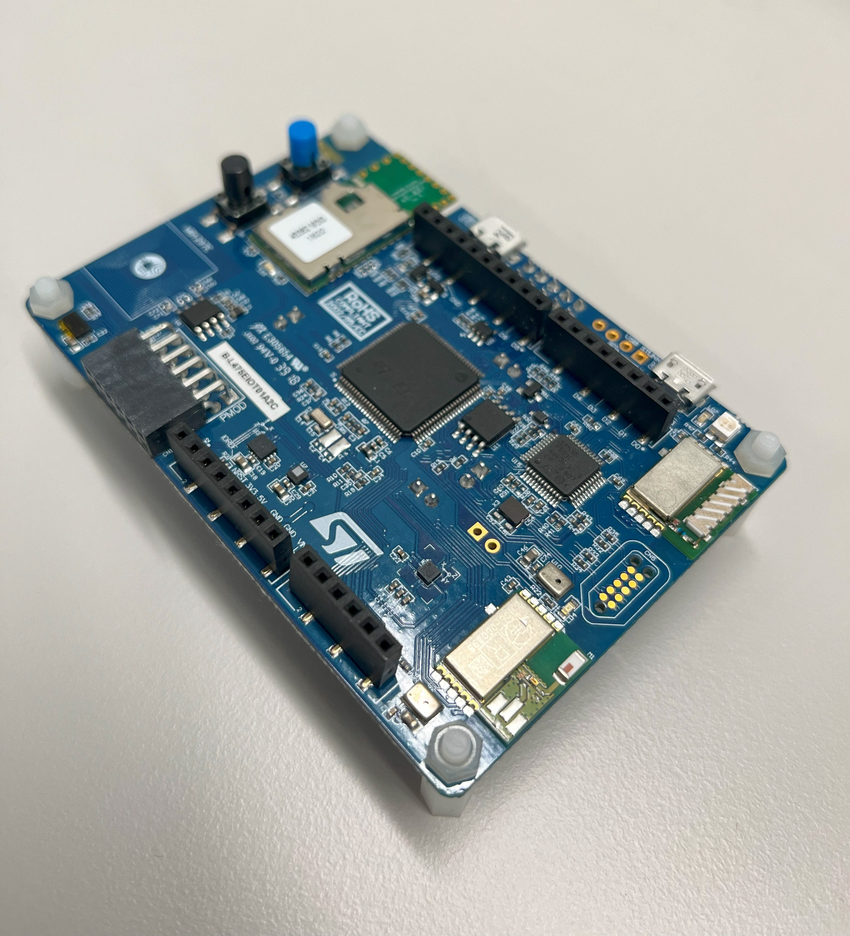
Hardware
Microcontroller: STM32L475VGT
Processor: Arm Cortex M4
Frequency: 80 MHz
1 MB Flash
128 kB SRAM

Slide 3

Model deployment
Simple to adapt to own models
More low-level control compared to using porting tools like STM CubeAI
Less optimized for STM32 platform

Slide 4
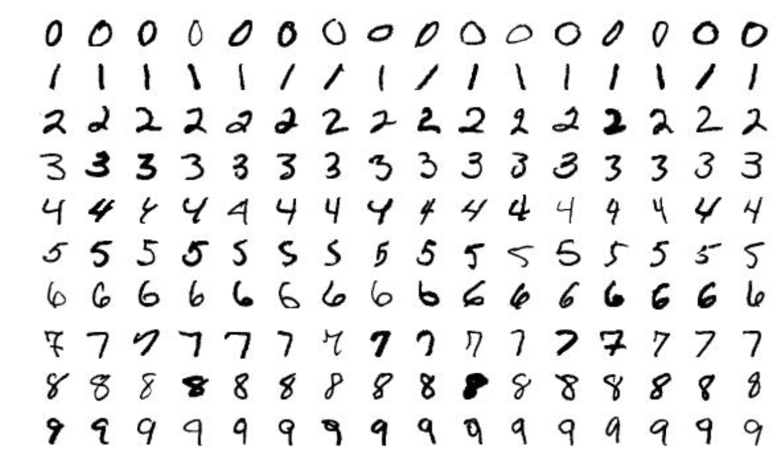
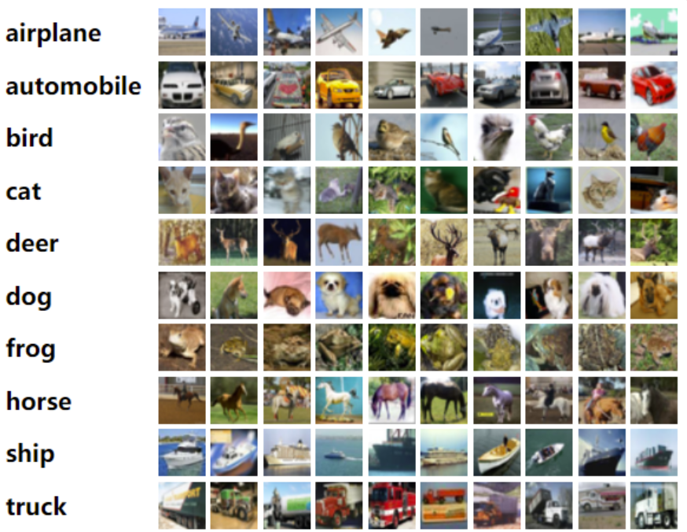
Problem Setup and Dataset
Image Classification on MNIST and CIFAR-10 datasets
Well known datasets -> Easily accessible
Applications in AVs/UAVs

Slide 5
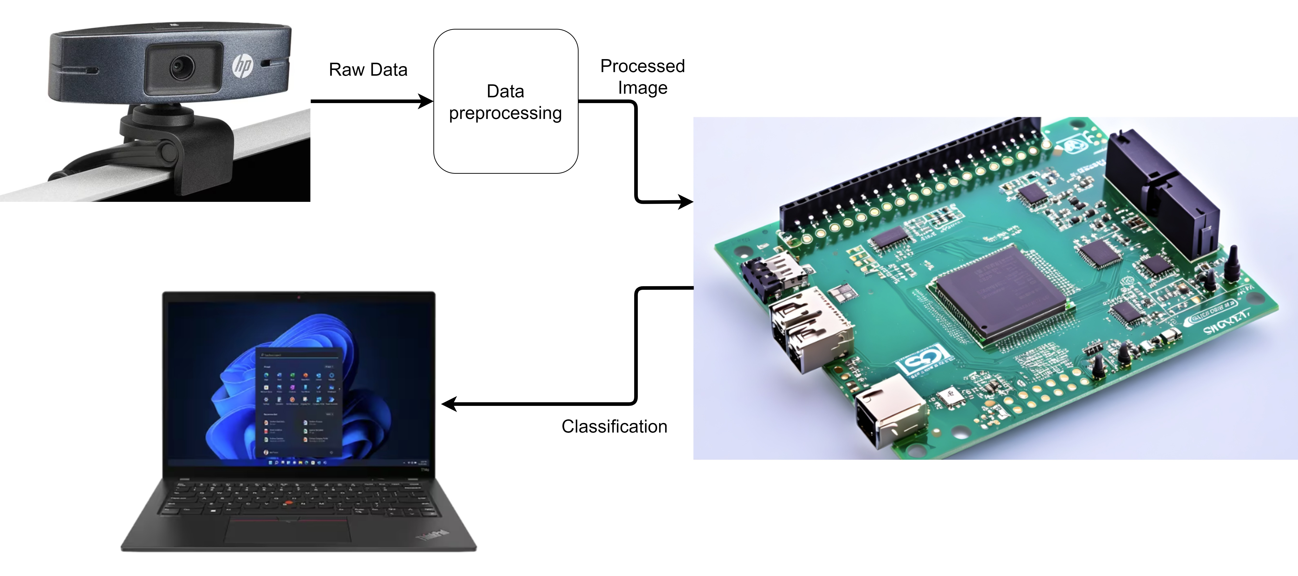
Data flow & Setup

Slide 6
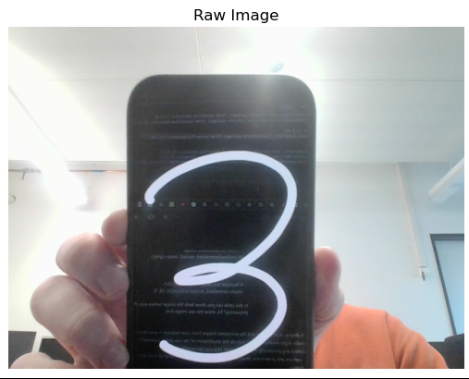
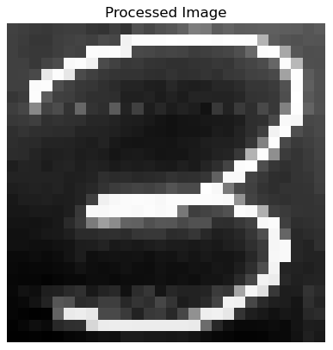
Image Preprocessing-MNIST
Convert image to grayscale and denoising
Apply adaptive thresholding to separate black & white pixels
Filter out main contours of digit -> leave out redundant part of image

Slide 7
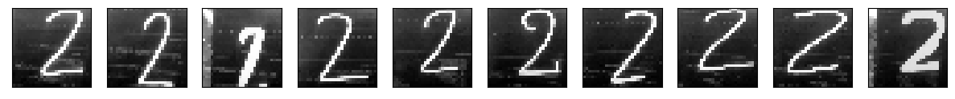
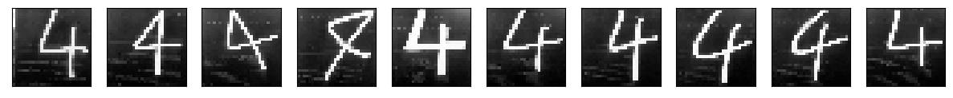
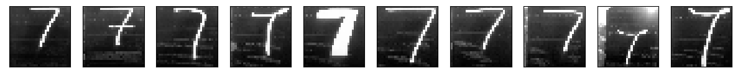
Handling Overfitting-MNIST
Images taken from the camera have «lower quality» than images from dataset
Create own dataset by recording images with laptop camera and add this dataset to existing MNIST data set to prevent overfitting
Rotate and stretch images in the training set to become less sensitive to slight differences in location of the digits

Slide 8
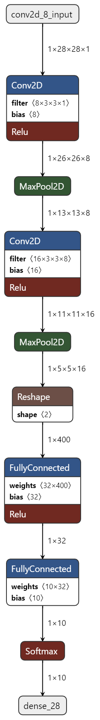
Model Architecture-MNIST
Specifications:
MAC: 208k
Flash Usage: 47.96 KiB
RAM Usage: 7.2 KiB
Inference Runtime: 16.355 ms
Accuracy: 98.8%
Layer | Runtime
Conv2D + MaxPool 2D | 15.8 ms
Dense | 0.1 ms

Slide 9
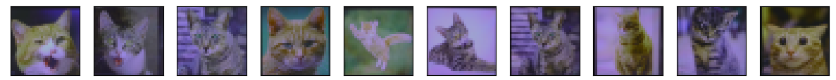
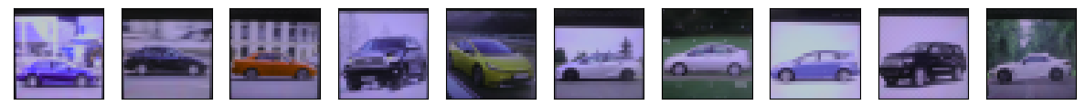
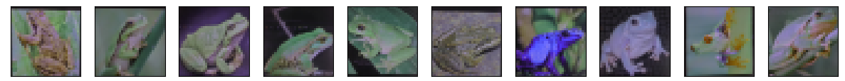
Handling Overfitting-CIFAR-10
To perform accurate inference on images taken from camera, we need to account for different quality in images
Read in web-images via laptop camera and preprocess them

Slide 10
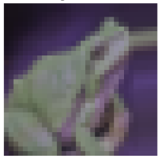
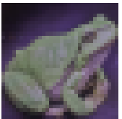
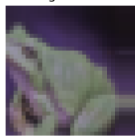
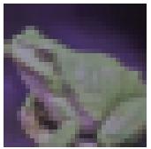
Handling Overfitting-CIFAR-10
Problem: CIFAR-10 Dataset has 50k images
Creating a dataset of comparable size is infeasible
Solution: Add images multiple times, but with noise injection
Example Augmentation
Original

Slide 11
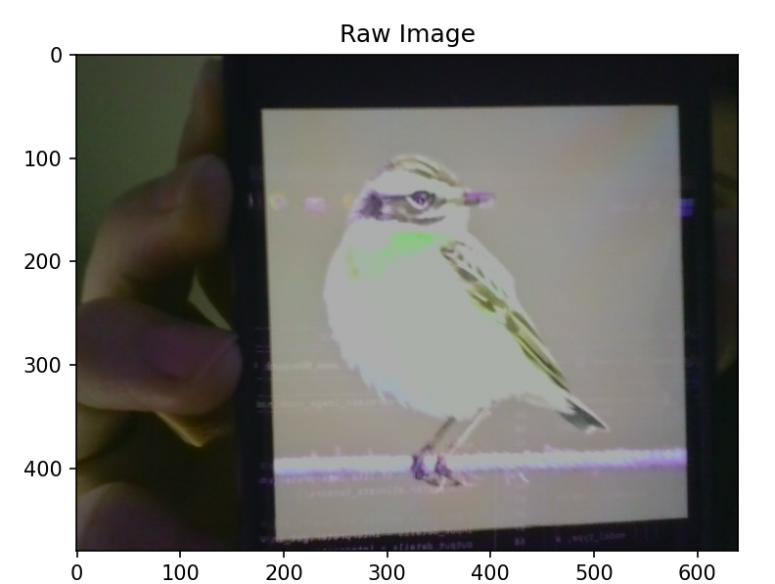
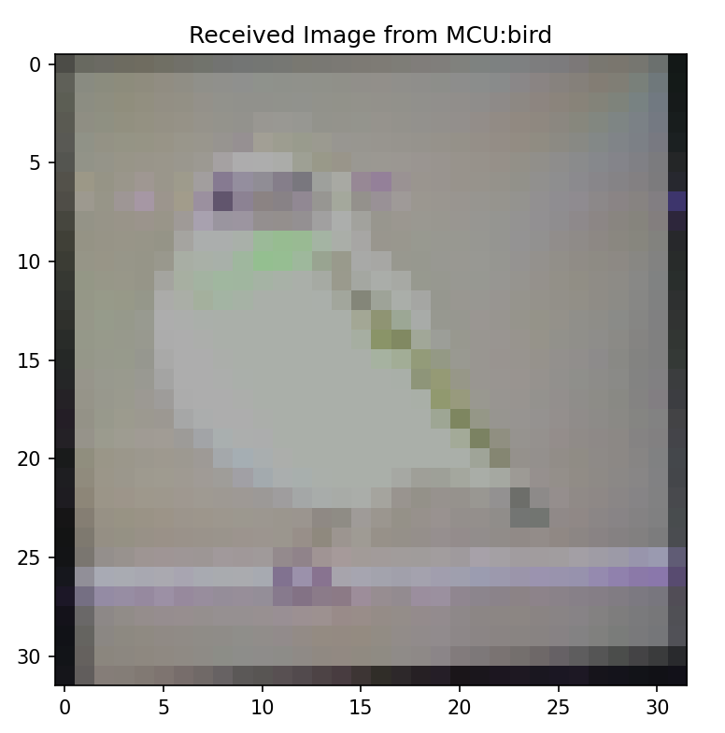
Image Preprocessing-CIFAR
Find box around the relevant part of the image and then send preprocessed image to the MCU

Slide 12
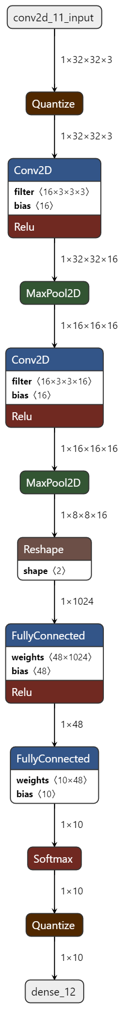
Simple Model Architecture-CIFAR10
Specifications:
MAC: 1.1M
Accuracy:
Full-precision accuracy: 66% ,
Quantized Accuracy: 65.7%
Quantization-aware-training accuracy: 65.7%
Model | Flash | RAM | Runtime
FP32 | 219 KiB | 73 KiB | 159 ms
INT8 | 14.21 | 53 KiB | 52.9 ms
Layer | Runtime
Conv2D + MaxPool 2D | 50.8 ms
Dense | 1.95 ms

Slide 13
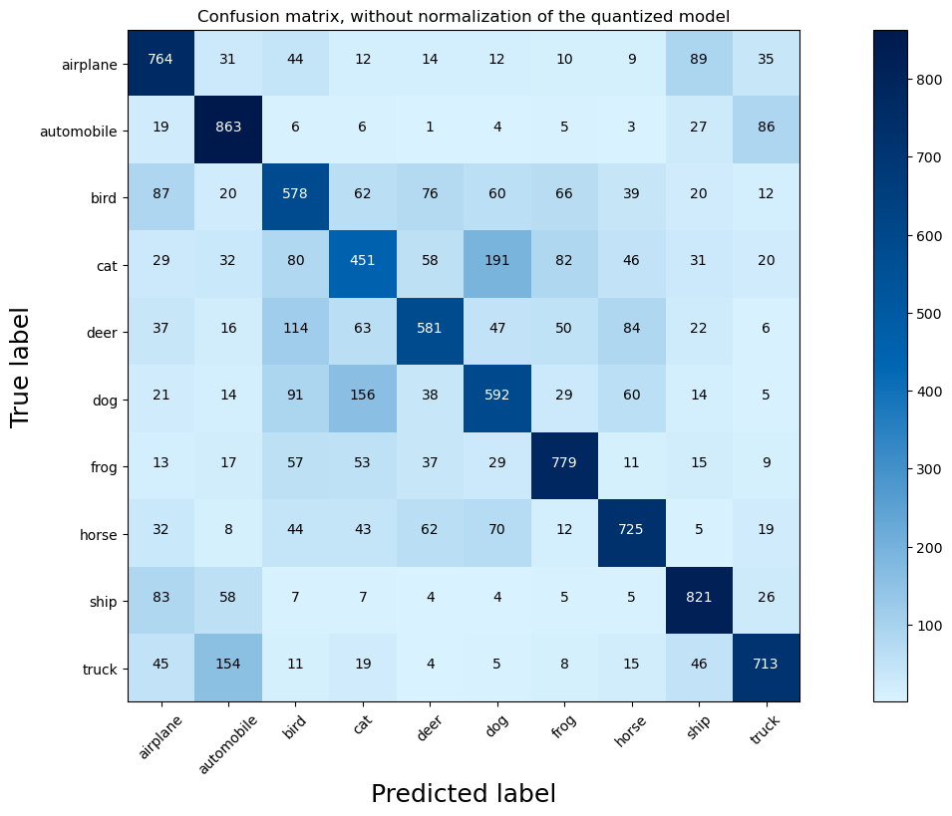
Confusion Matrix-CIFAR10
Some classes still perform significantly worse than others (e.g. Cat vs Dog)

Slide 14
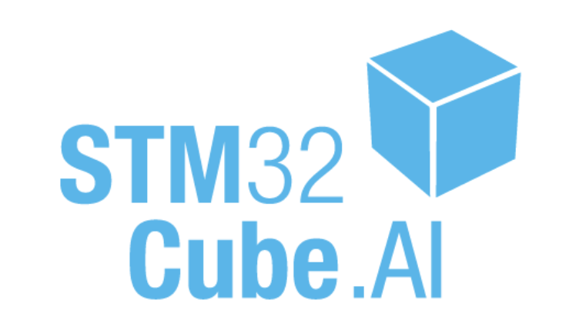
Porting larger models
Easy to use
Produces more optimized code than Tflite
Sometimes unexplainable errors
Less control over code

Slide 15
Middle Sized Models on CIFAR-10
Creating deeper models enhances accuracy
Specifications:
MAC: 28M
Full-Precision Inference Runtime:
Quantized Inference Runtime: 743 ms
Accuracy:
Full-precision accuracy: 72.57% ,
Quantized Accuracy: 72.9%
Quantization-aware-training accuracy: 73%
Model | Flash | RAM
FP32 | 997 KiB | 147 KiB
INT8 | 362 KiB | 53 KiB

Slide 16
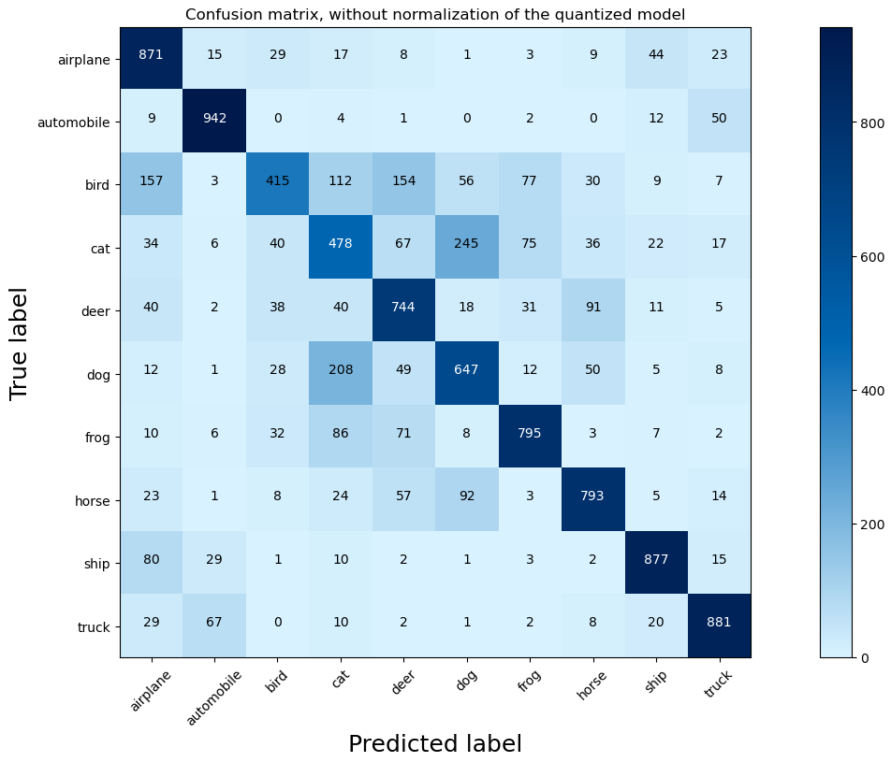
Middle Sized Model: Confusion Matrix

Slide 17
Reaching the memory limit of STM32
Model | Flash | RAM
FP32 | 2.32 MiB | 147 KiB
INT8 | 777 KiB | 53 KiB
Specifications:
MAC: 435M
Inference Runtime: 1.13s
Accuracy:
Full-precision accuracy: 82.5% ,
Quantized Accuracy: 81.7%
Quantization-aware-training accuracy: 82.9%

Slide 18
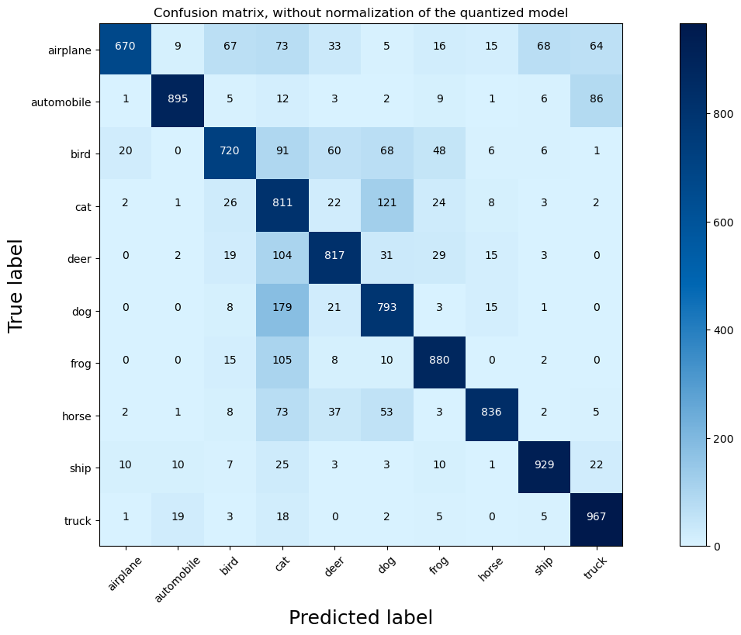
Large Sized Model: Confusion Matrix

Slide 19
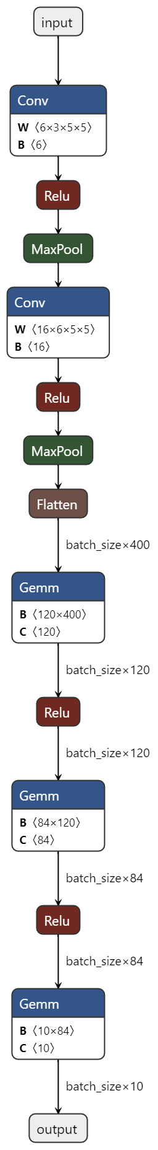
Pre-trained LeNet model on CIFAR-10
One of first models to use CNN layers [LeCun et al. 1988]
Specifications:
MAC: 666k
RAM Usage: 58.25 KiB
Flash Usage: 27.72 KiB
Inference Runtime: 110ms
Accuracy: 50.61%

Slide 20
Difficulties
In the beginning put focus on developing Pruning techniques from scratch in tensorflow
Abandoned this track as Pruning did not seem to improve memory footprint
Script with Pruning methods can still be found on moodle
Porting transformer:
Many kernels used in transformer missing support in CubeAI

Slide 21
Future Work
Apply another neural network for image preprocessing and contour detection
Perform preprocessing fully on the edge
In real scenarios such as self-driving cars, outsourcing computation to cloud is too latency-intensive and unreliable

